Slide 1
Strategic Cybersecurity Methodology & Insights
Andrew Roberts
Chief Cybersecurity Strategist

Slide 2
Step 1: Choose a Framework

Slide 3
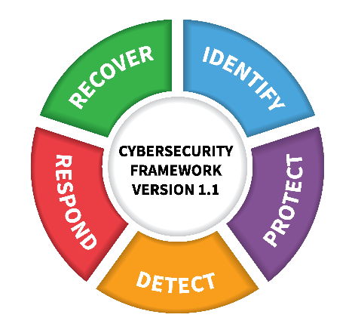
Cybersecurity Frameworks
Designed towards CIKR, but built for organizations of all sizes
Customizable
Outcome driven, without mandates
Scalable

Slide 4
Cybersecurity Frameworks
Critical Security Controls
Set of high-importance, highly effective recommended actions
Prioritized
Used by any size and type of organization

Slide 5
Cybersecurity Frameworks
Used by healthcare organizations
Comprehensive, Flexible, Efficient
Regulatory Compliance & Risk Management
Draws from ISO, NIST, PCI, & HIPAA

Slide 6
Step 2: Get Buy-In

Slide 7
Talking to Executives
See & Show the Big Picture
Cybersecurity is RISK MANAGEMENT

Slide 8
Optimizing the Cost of Cybersecurity
$$$
True Cost
Optimized Cost
Residual Risk
Time

Slide 9
Step 3: Gap Analysis

Slide 10
Gap Analysis
OPTIONS
DIY
Insider Look
Cost Savings
High Risk of Bias
Trusted 3rd Party
Faster
Outside Opinion
Objective View
Assess ALL Controls in Your Chosen Framework
This is for You – BE HONEST
Set the Bar in the Right Place

Slide 11
Step 4: Program Roadmap

Slide 12
Identify Objectives
Short Term
Low Hanging Fruit
Quick Wins
Build Security Culture
Mid Term
Get Tactical
Go for Synergies
Long Term
Get Strategic
Adjust as Needed

Slide 13
Execute, Monitor & Adjust
Work Your Plan
Be confident in the plan
Get everyone involved
Track Progress
Continuous monitoring
Benchmark against the framework
Course Correction
Watch for drift

Slide 14
Reporting
For You
Track Progress
Identify Roadblocks
Feedback Look
For Your Leadership
They Are Interested and Invested
Keep Them Engaged

Slide 15
<<Company Name>>
Strategic Planning

Slide 16
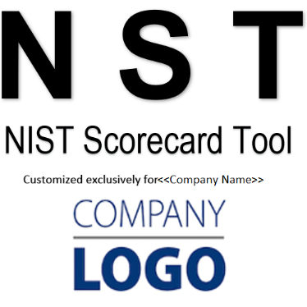
Beyond the Report

Slide 17
Original State

Slide 18
Short-Term Objectives
Policy Development, Phase 1
User Awareness Program
Patch & Vulnerability Management
Managed SOC | MSSP
Dataflow Mapping
Data Security Assessment

Slide 19
Initial Progress
Original State
After Short-Term Objectives

Slide 20
Medium-Term Objectives
Policy Development, Phase 2
Data Security
Incident Response
Vendor Risk Management
Identity & Access Management | Privileged Access Management

Slide 21
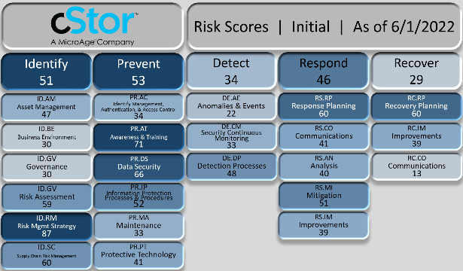
Further Progress
Original State
After Medium-Term Objectives

Slide 22
Long-Term Objectives
Network Segmentation
Disaster Recovery/Business Continuity
Change Management
GRC

Slide 23
The Future State
Original State
After All Objectives

Slide 24
Hello
Rick Trujillo
Director of Cloud and Services Presales

Slide 25
Managed Infrastructure
Security & Support for
Servers
Virtualization
Storage, Backup & Data Protection
Managed Network
Security & Support for
Firewall
Switching & Routing
Wi-Fi
Network Devices
Managed Cloud
Security & Support for
Microsoft 365
Azure Cloud
Help Desk
End User Support for
Triage
Desktop & M365
User Administration
On-Site Services
Professional Services
Project Management for
Microsoft
Data Center & Network
Security
UCaaS
ManageWise
Proactive Maintenance & Support for
Data Center & Network
Cloud
Custom IT
On-Site Services

Slide 26
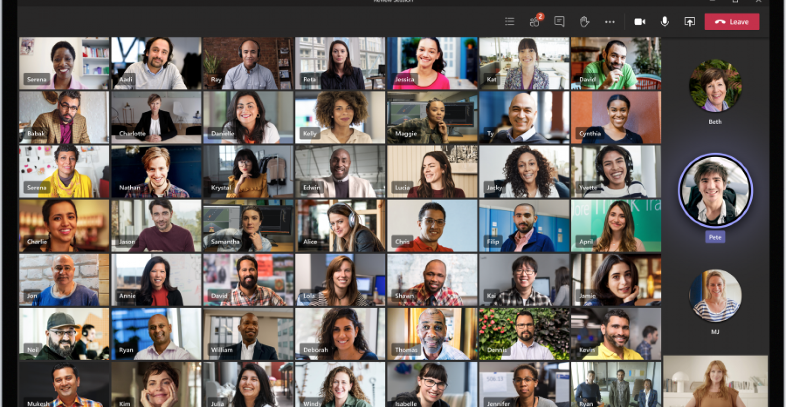
We talk to a lot of clients.

Slide 27
Today’s Client – MSP Evaluation
Increase in businesses evaluating the outsourcing of managed services and help desk services for the first time.
Increase in businesses evaluating a change of current managed services and help desk providers, due to:
Inability to adjust to rapid change in client requirements.
Inability to focus on modernization of the client’s business.
Failure to meet support requirements.
Inability to do more than managed services.
Security and Compliance
End User Support Services
Advanced Specializations through third party
Hardware and Software provisioning
Licensing

Slide 28
Managed Services / Help Desk Onboarding
Kick-Off
Establish key contacts, escalation paths and procedures
Scheduling of weekly calls
Secure Access
Gain access to all relevant areas with secure password management
Discovery and Review
Processes and relevant documentation
Infrastructure
Licensing and Support Agreements
Backups
Maintenance Windows
ISP Information
Remediate
Infrastructure
Backups
Licensing
Support agreements
Go-Live
Scheduling of monthly support calls
Continuous Realignment
Quarterly Business Reviews
CSAT and KPI’s, Communication
Infrastructure changes
Licensing and Support agreement Changes
Contract Changes

Slide 29
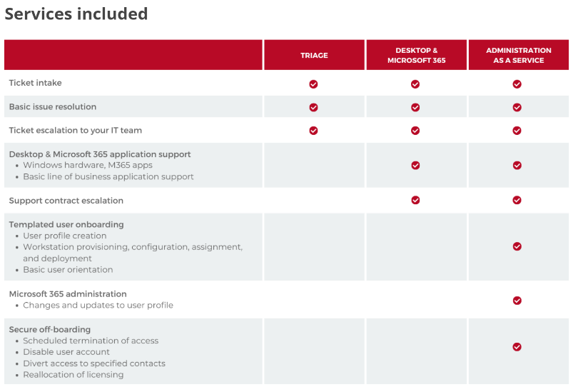
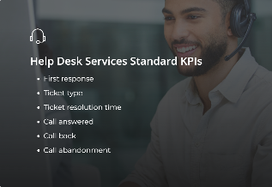
Help Desk Services
Onboarding Process
Documentation
Continuous Realignment
Quarterly Business Review

Slide 30
Documentation and Processes
How are you managing your users today?
Help Desk
User Administration/lifecycle Workflow
Do you have SOP’s and Documentation to support managing of users?
Where do you store it?
How do you maintain it?
80% of IT Leaders feel they are “Not centralized”
60% of Department Heads “Not communicating with other departments”

Slide 31
Microsoft Entra
Suite of Identity related Solutions.
Admin Center dedicated to all Components of Identity Management.
Consolidates features of several different Admin centers into one.
Azure Active Directory – ID and access management
Verified ID – Creates Trust between a user’s privacy credentials and a verifier
Permissions Management – Inventory and management of permissions/privileges across multiple clouds
Identity Governance – Lifecycle workflows of the user

Slide 32
Quick Reminder: Post Webinar Survey
One lucky winner will win an Omaha Steak Gourmet Package valued at over $200 just by filling out our quick 4 question post-webinar survey!
Any comments or questions left in survey go directly to your Account Executive
Survey link in the chat box – winner will be drawn and notified tomorrow, March 1 so get it done today!

Slide 33
Microsoft Licensing CSP New Commerce Experience
The window for most Commercial CSP/NCE renewals is between now and March 31st, 2023.
What we saw in 2022, and going into 2023
Misinformation about the program is still floating around out there
Support and licensing expertise is still an issue within the CSP Partner Community
Upon renewal in 2023
Price changes are in effect
Early adoption promo going away
Core M365 products are subject to 2022 price increase
Changes are in effect
Plan cross grade/downgrade changes
Quantity Reductions
Partner changes

Slide 34
Microsoft Licensing CSP New Commerce Experience
Enterprise Agreement customers
Evaluation of EA vs CSP amongst Microsoft customers is up 50%
Transition from EA to CSP is up 25%
Flexibility
Cost
Risk
Support
Changes to EA qualification
Software Assurance challenges

